Slide 1


Summer Internship 2021
Presentation on Consultancy service company application

Slide 2
HELLO!
Our Team:
Vivek Mehta (19CE074)
Nikita Mirchandani (19CE076)
Jainil Shah (19CE135)

Slide 3
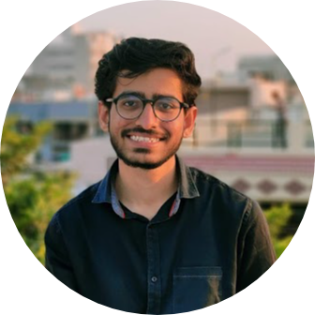
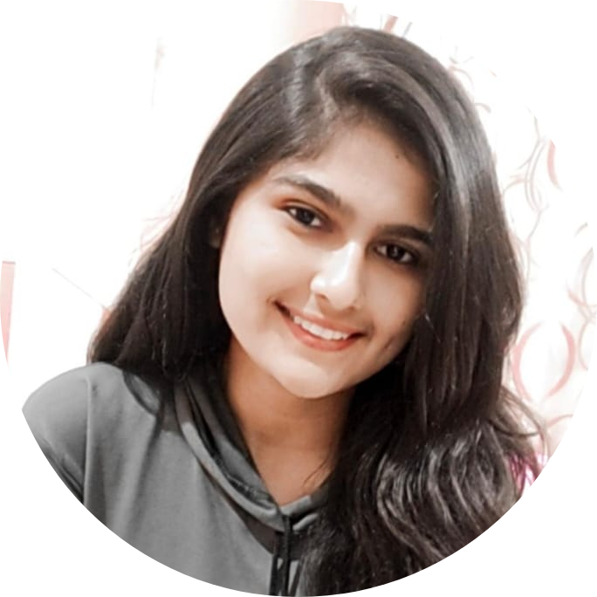
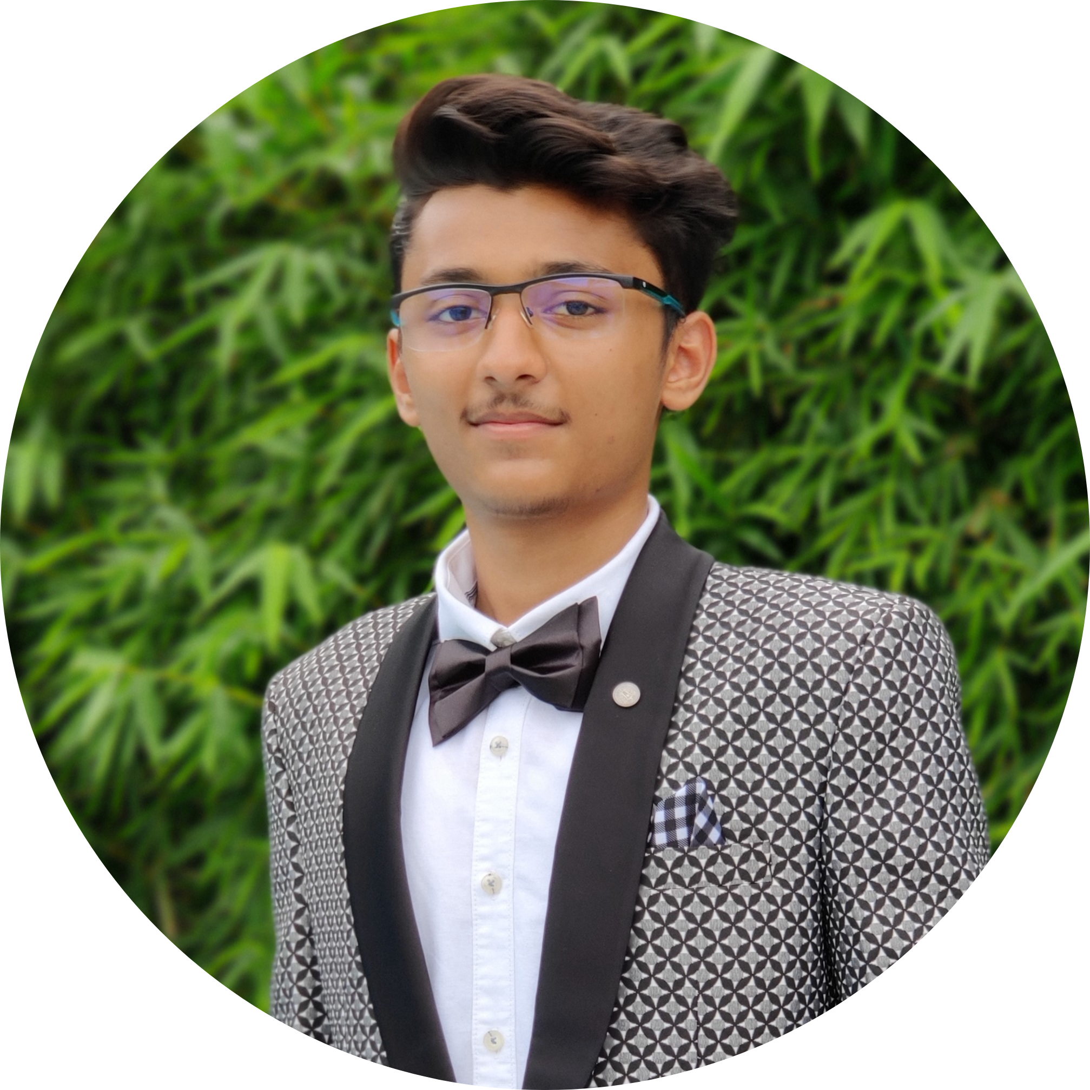
Team Roles
Vivek Mehta 19CE074
Front-end Designer
Nikita Mirchandani 19CE076
Database Designer
Jainil Shah 19CE135
Front-end Designer

Slide 4
Contribution
6
Teamwork and management

Slide 5
Vivek Mehta (19CE074)
Dashboard UI design
Modules’ Front end Development
Nikita Mirchandani (19CE076)
Back-end of all modules
Database and server set-up
Email functionality
Jainil Shah (19CE135)
Splash Screen, login page design
Dashboard UI design
Graph module
UI remodelling

Slide 6
Contents
Contribution
Project Definition
Project Description
Problems faced by the clients in today’s situation
Motivation behind the project
Purpose and target users
Development Environment
UI (Flow Chart)
Implementation Screenshots
Limitations and Future Enhancements
Challenges faced by us & Conclusion
References

Slide 7
Project Definition
1
Let’s start with the defining the project

Slide 8
From the Company’s perspective;
This application is aimed at providing an interface to the consultancy company to manage their clients and employees
Viewing the employee lead and earning statistics has been made easier
From the Clients’ perspective;
Leads:
It is aimed at making services like training, education, insurance, loans, HR; available to the leads at their fingertips

Slide 9
Project Description
2
Some brief points describing the project

Slide 10
The consultancy app consists of the following modules:
Admin Module
Sub-modules for managing employees, branches and partners.
Employee Module
Sub-modules for managing partners, branches and their leads.
Partner Module
Insert and view candidate profiles for Job, Loan, HR,etc.
Branch Module
Sub-modules for creating partners, creating candidate profiles, view commission structure and reports

Slide 11

What was our task?
We were assigned with the task of creating the Admin Module

Slide 12
Motivation
3
The current problems and motivation behind the app.

Slide 13
In today’s era of dynamic technological development, few of the firms not engaging in these activities are at a disadvantage
This puts the clients at a disadvantage and leads them getting baited into false leads.
Thus, our application is aimed at providing the consultancy firms with a platform with a user-friendly interface.
Our major motivation was creating an integrated environment with all the necessary modules that could be controlled and monitored by the admin.

Slide 14
Target Users
4
People using the App

Slide 15
Consultancy app (Basic Functionalities):
Firm employees
Firm partners
Firm Branches
Consultancy App (Admin Module):
Company admin
Managers

Slide 16
Development Environment
5

Slide 17
Development Environment and Tools Used :
Android studio is the official IDE for android application development. It enhances our productivity while building apps.
Our app has been built using Java as the development language
MySQL(PhpMyadmin) was used for the database
Php was used as the language for performing backend tasks

Slide 18

Some Android Studio Features :
Android studio has VISUAL LAYOUT EDITOR feature
Android studio has APK ANALYZER feature
Android studio has FAST EMULATOR feature
Android studio has INTELLIGENT CODE EDITOR feature
Android studio has FLEXIBLE BUILD SYSTEM feature
Android studio has REALTIME PROFILERS feature

Slide 19
UI (flow Chart)
6
The flow of application

Slide 20
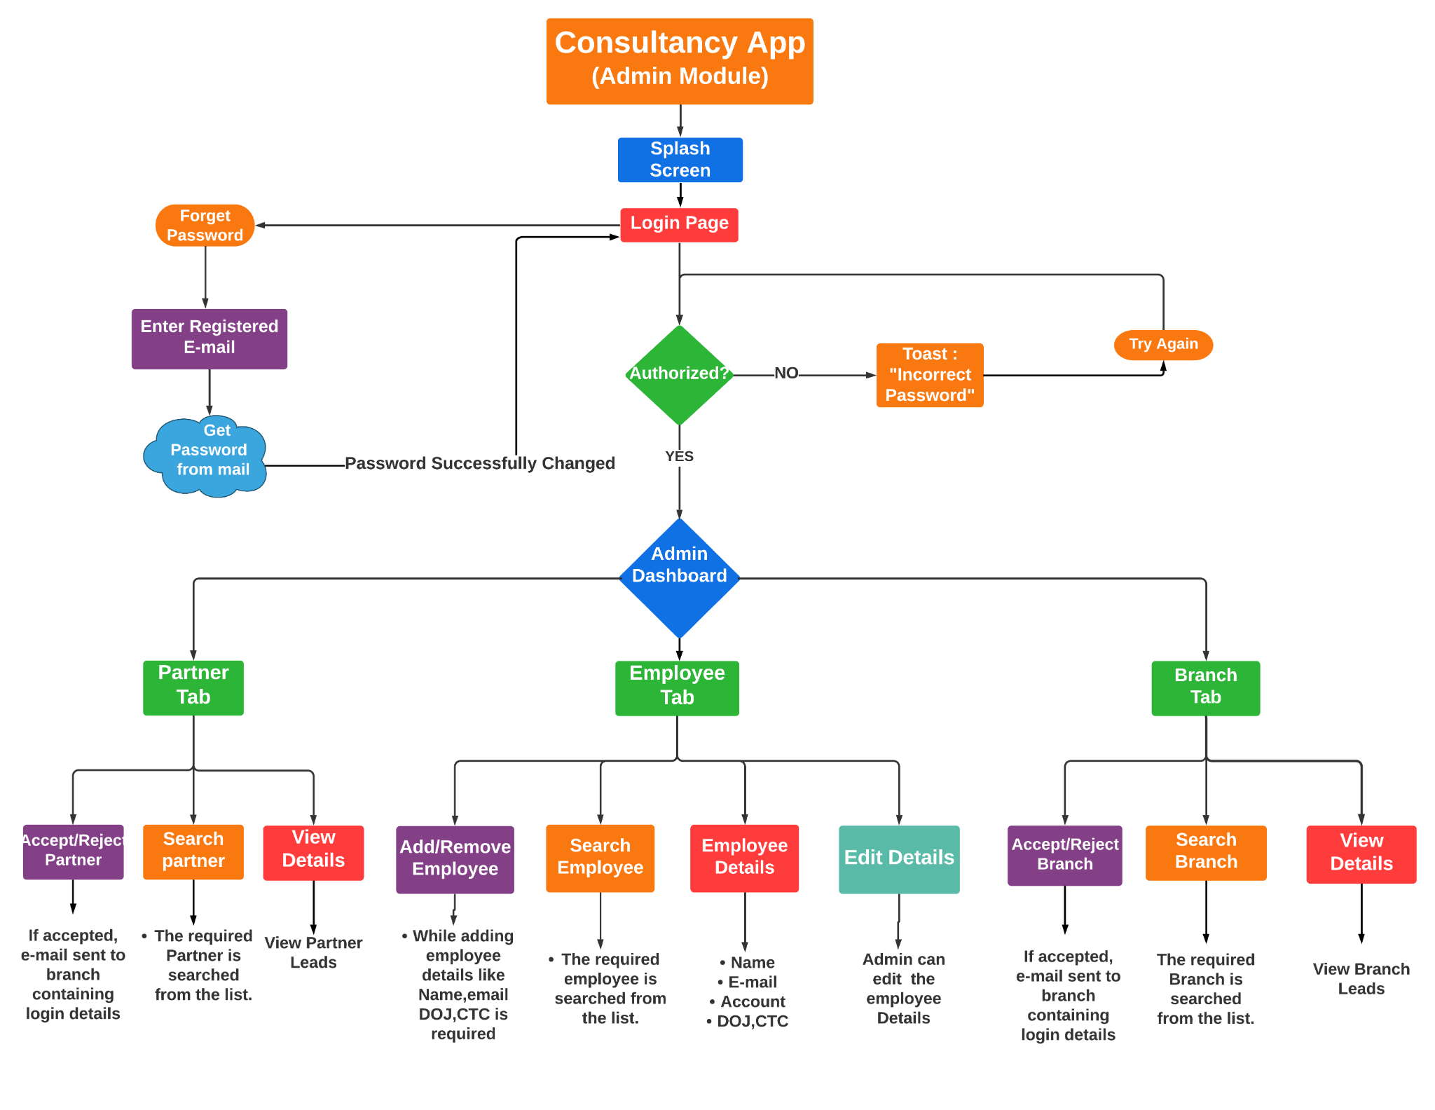

Slide 21
Implementation
6
The Road map and app screenshots

Slide 22
Roadmap
Discussion and project understanding. Requirement gathering
Employee Module creation and admin profile option
View Employee, Branch and Partner Leads Option and Graph module creation
Week
Week
Week
1
3
5
Week
2
Week
4
Week
6
User Login ,signup and Dashboard design
Partner Module, Branch Module creation
Final Testing and compatibility checking

Slide 23
Weekly Planner
 | MONDAY | TUESDAY | WEDNESDAY | THURSDAY | FRIDAY | SATURDAY
09:00 - 09:30 | Scrum meeting | Scrum meeting | Scrum meeting | Scrum meeting | Scrum meeting | Scrum meeting
9:30 - 10:45 | Task | Task | Task | Task | Task | Task
11:00 - 11:45 | Task | Task | Pair Programming | Task | Task | Pair Programming
12:00 - 13:15 | ✔ Free time | ✔ Free time | ✔ Free time | ✔ Free time | ✔ Free time | ✔ Free time
13:30 - 14:15 | Task | Task | Task | Task | Task | Task
14:30 - 15:15 | Testing | Merging modules | Task | Testing | Merging modules | Task
15:30 - 16:15 | Collaborating | Collaborating | Mid weekly reporting | Collaborating | Collaborating | Final Weekly Reporting

Slide 24
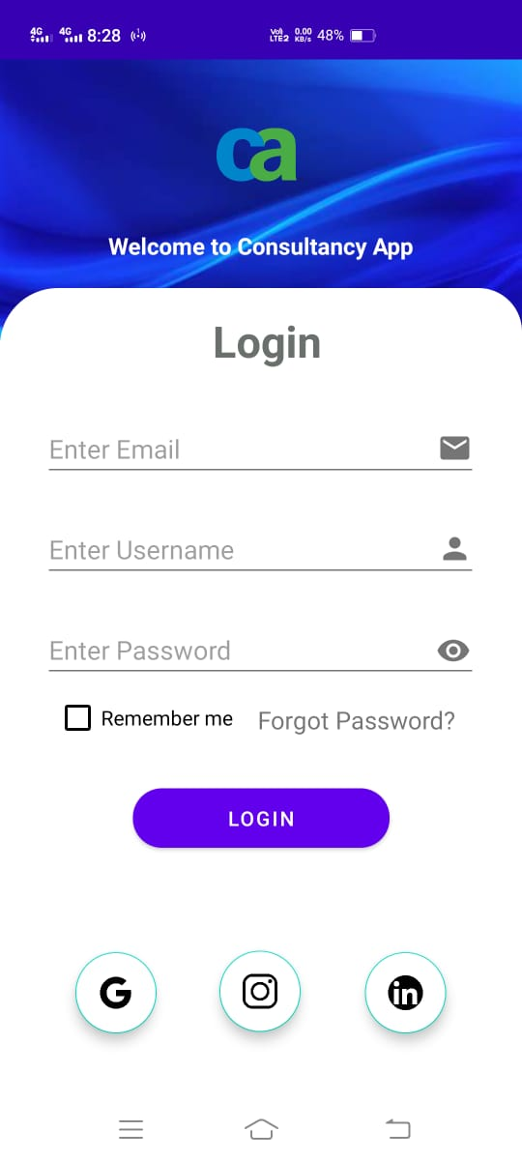
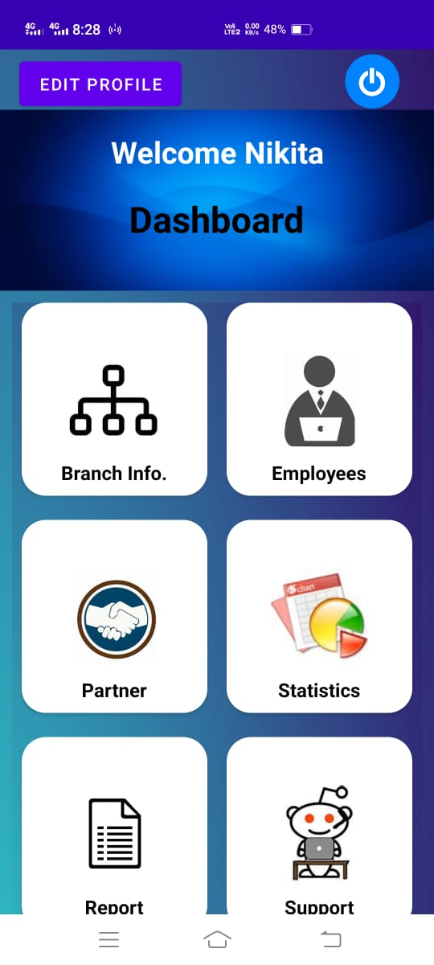

Slide 25
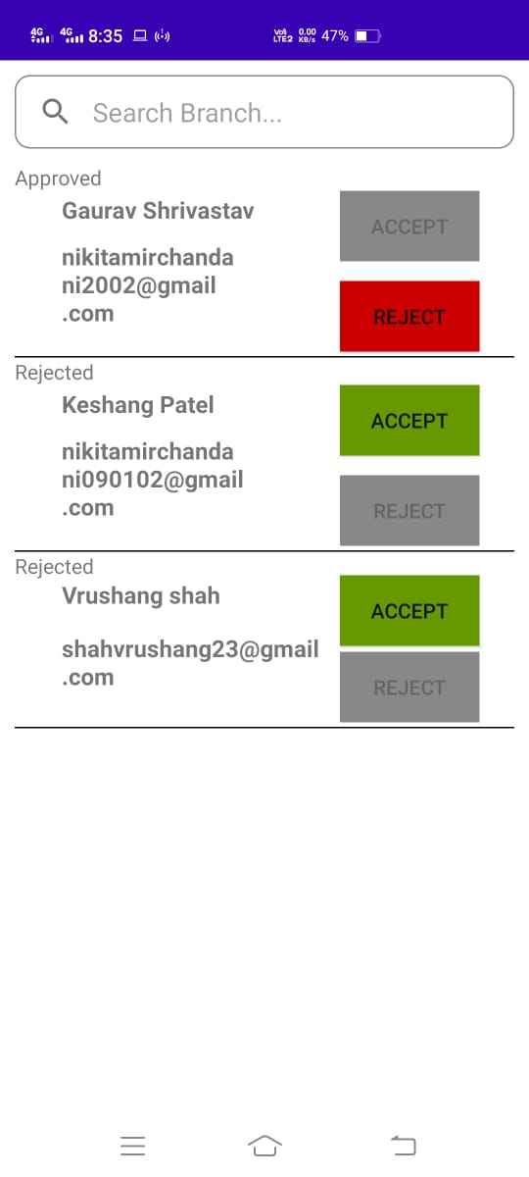
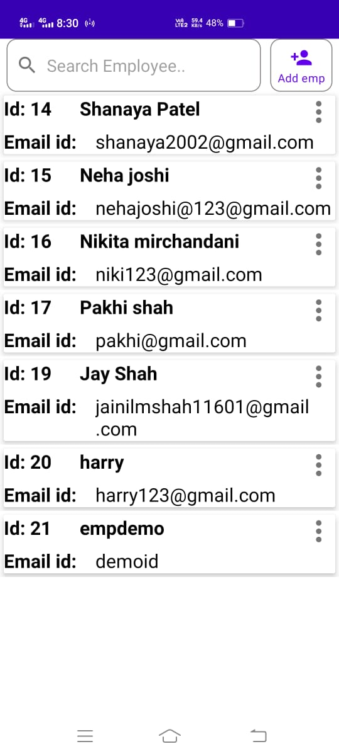

Slide 26
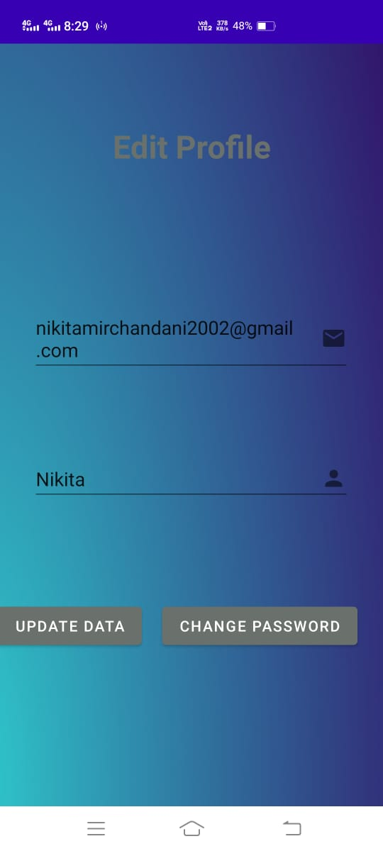
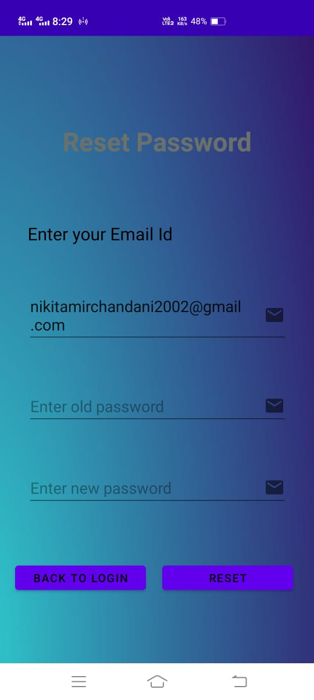

Slide 27
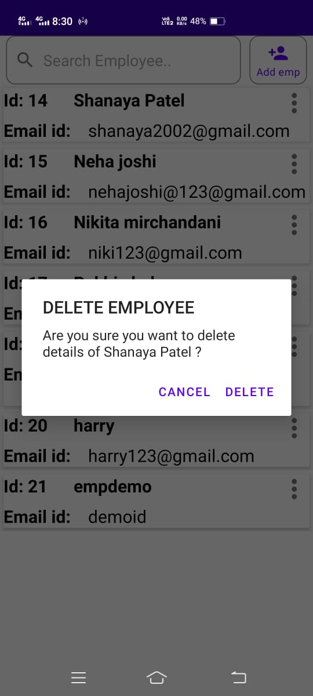
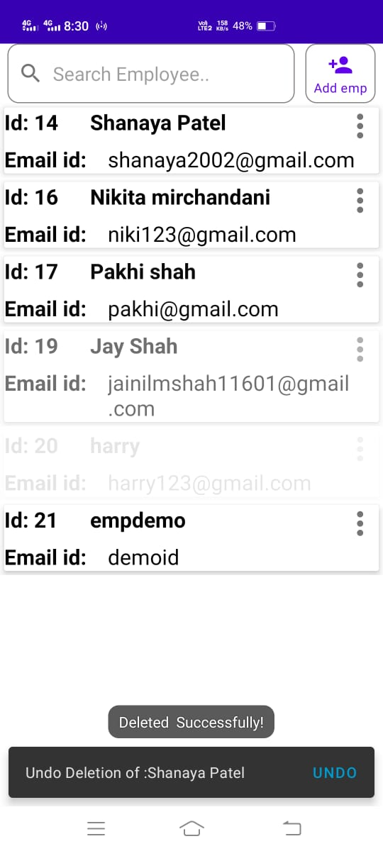

Slide 28
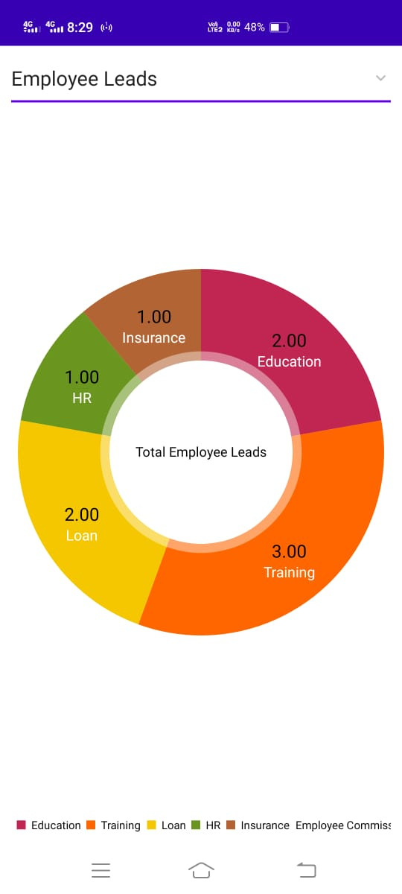
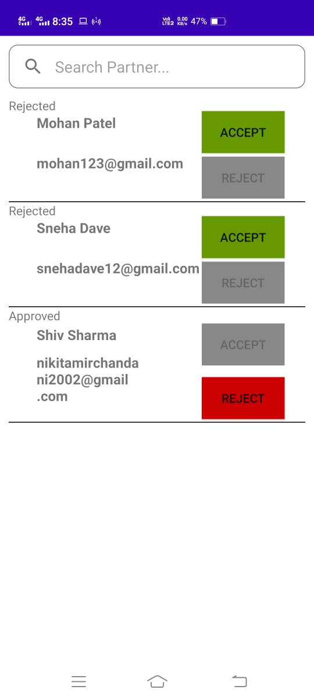

Slide 29
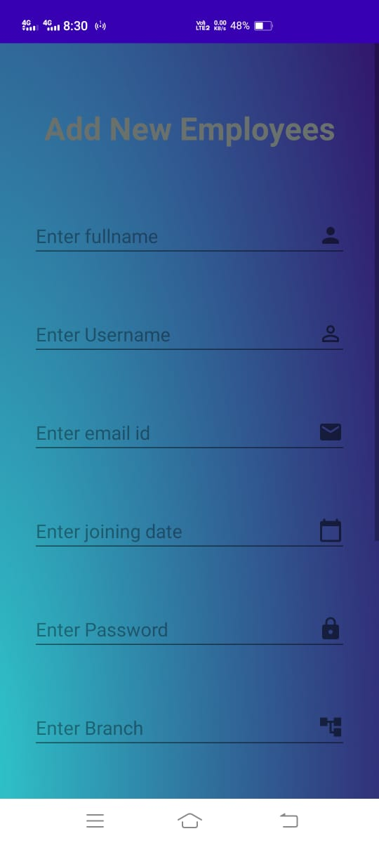
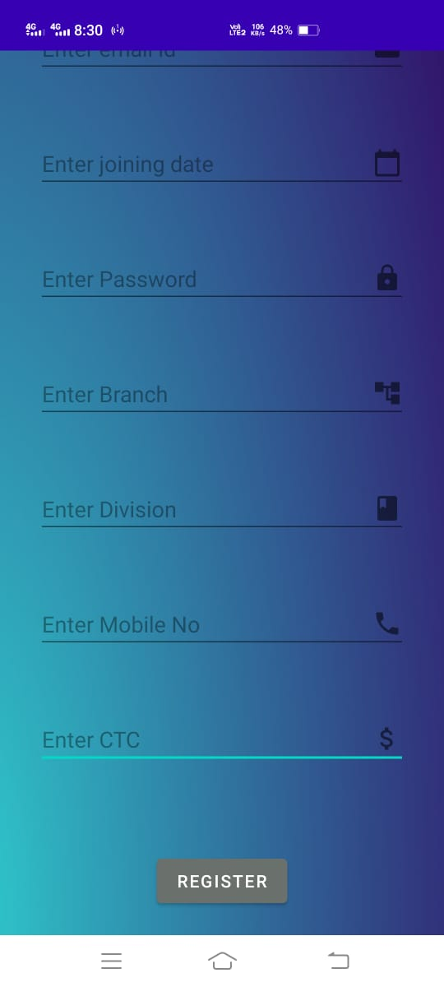

Slide 30
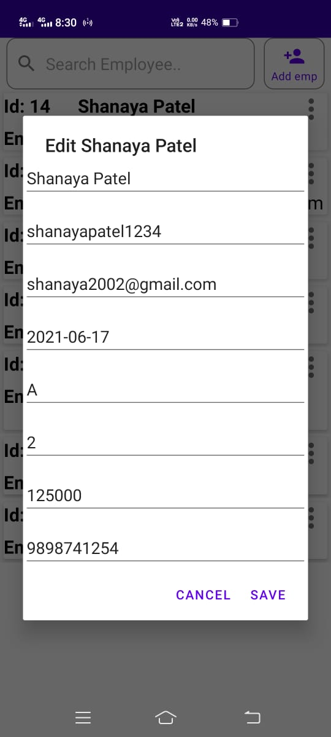
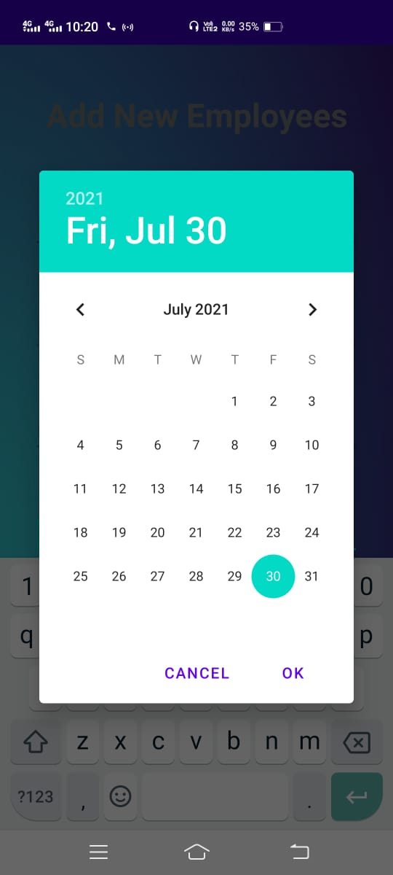

Slide 31
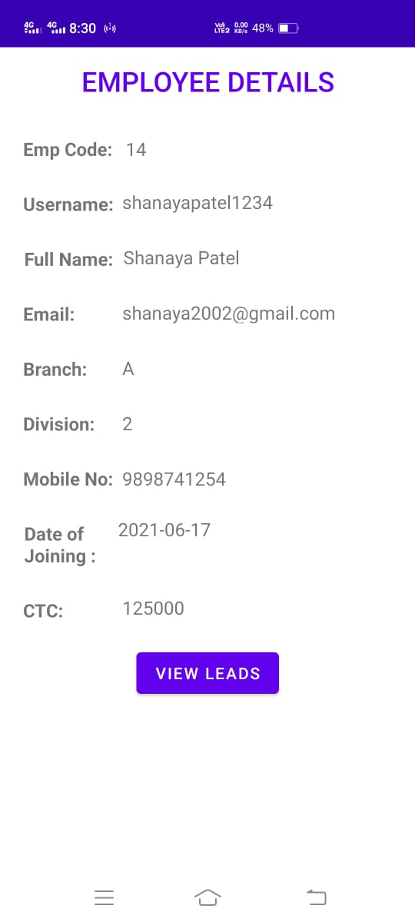
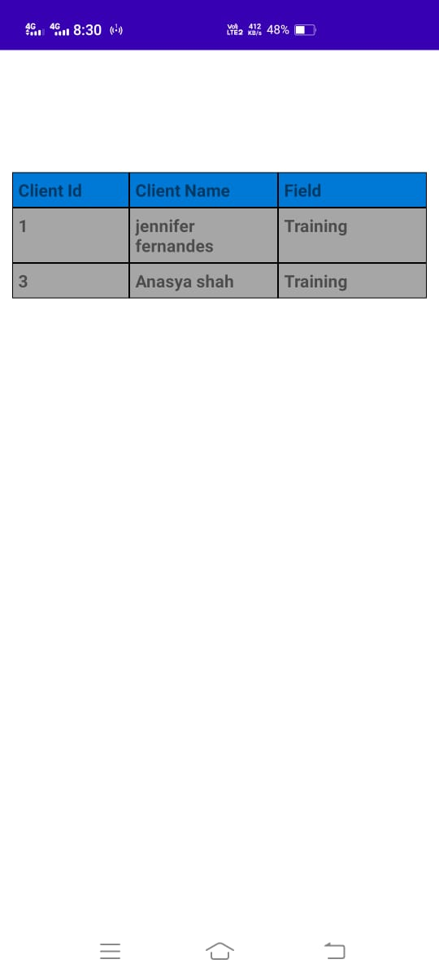

Slide 32
Limitation and Future Work
6
What’s next?

Slide 33
The current app does not give the commission statistics and incentive report of the leads of the partner and branch module.
Future Work:
To implement the Report module which gives the stats of the leads of the partner and branch module respectively.
To implement sort functionality in the modules for better user experience.

Slide 34
Challenges & Conclusion
6

Slide 35
Challenges
1) Mail service : It wasn’t generating different Id passwords to different branches and partners when the particular request of branch/partner is approved by admin. Using some logic in php file we were able to generate different passwords and ids to the particular branch/partner.
2)Graph Module : The problem we were facing in graph module was the accessing the json data from php files to java file(in android studio) but by trial and error method & implementing various logic , we had solved that problem.
3)Accept/Reject request : Initially we kept accept and reject button enable even after accepting and rejecting the requests of branch/partner.But we solved that problem by making that button disable after clicking on it. Even admin can accept the request after rejecting it. So both options are available.
4)RecyclerView : We were facing problems in making the recycler view of employees clickable as it is difficult to take particular employee’s detail in next tab and show leads accordingly. But it is solved by watching many tutorials regarding clickable recyclerview.
5)View leads : We faced problem to connect leads of particular employee/branch/partner to show with their fields and ids. We solved it using an extra variable in db to show which employee is being selected.

Slide 36
Conclusion
Consultancy app made Admin’s work easy because
Accepting and rejecting request is now automatic .
An automatic mail is being sent to the mail id of given
employee/partner/branch with automatic generated
id and unique password .if admin clicks on accept button.
Consultancy app gives interface to admin for managing the details of their employees ,partners and branches along with their leads.
Our app will analyze employee lead and earning statistics which makes it easier to monitor what changes has been made in that particular time
It produces graph of employee leads,partner leads and branch leads so Company admin/manager can analyze the amount of leads the company getting from particular employees/partners and branch.
An mobile application is way easier than keeping track of records offline.

Slide 37
References
6

Slide 38
· http://jservice.io/api/clues
· https://api.github.com/search/users?q=language:java+location:lagos
· https://youtu.be/CTvzoVtKoJ8
· https://www.youtube.com/watch?v=Px9KanE-ohk
· https://youtu.be/BQj7vahVvhE
· https://youtu.be/JkJ0k8zMsZU
· https://youtu.be/ayKMfVt2Sg4
· https://youtube.com/playlistlist=PLu0W_9lII9aiL0kysYlfSOUgY5rNlOhUd
· https://youtu.be/4e8be8xseqE
· https://www.simplifiedcoding.net/android-volley-example-to-load-image-from-internet/
· https://stackoverflow.com/questions/45940861/android-8-cleartext-http-traffic-not-permitted
· https://www.youtube.com/watch?v=X2mY3zfAMfM

Slide 39
THANKS!

